Slide 1
Chapter 10 – Strings and Characters
Outline
10.1 Introduction
10.2 Fundamentals of Characters and Strings
10.3 String Constructors
10.4 String Methods length, charAt and getChars
10.5 Comparing Strings
10.6 String Method hashCode
10.7 Locating Characters and Substrings in Strings
10.8 Extracting Substrings from Strings
10.9 Concatenating Strings
10.10 Miscellaneous String Methods
10.11 Using String Method valueOf
10.12 String Method intern
10.13 StringBuffer Class
10.14 StringBuffer Constructors
10.15 StringBuffer Methods length, capacity, setLength and ensureCapacity

Slide 2
Chapter 10 – Strings and Characters
10.16 StringBuffer Methods charAt, setCharAt, getChars and reverse
10.17 StringBuffer append Methods
10.18 StringBuffer Insertion and Deletion Methods
10.19 Class StringTokenizer

Slide 3
10 key to strings
1) Strings are not null terminated in Java.
2) Strings are immutable and final in Java
3) Strings are maintained in String Pool
    JVM first checks String pool and if an object with similar content available, than it returns that and doesn't create a new object.
    JVM doesn't perform String pool check if you create object using new operator.
    intern() helps to put any string to pool
4) Use Equals methods for comparing String in Java
5) Use indexOf() and lastIndexOf() or matches(String regex) method to search inside String
6) Use SubString to get part of String in Java
7) "+" is overloaded for String concatenation(using SBf or Sbu)
8) Use trim() to remove white spaces from String
9) Use split() for splitting String using Regular expression
10) Don't store sensitive data in String

Slide 4
String vs stringbuffer vs stringbuilder
Immutable vs mutable vs mutable
Ok vs threadsafe vs ok
toString() used to convert mutable to immutable

Slide 5
10.1 Introduction
String and character processing
  Class java.lang.String
  Class java.lang.StringBuffer
  Class java.lang.Character
  Class java.util.StringTokenizer

Slide 6
10.2 Fundamentals of Characters and Strings
Characters
  “Building blocks” of Java source programs
String
  Series of characters treated as single unit
  May include letters, digits, etc.
  Object of class String

Slide 7
10.3 String Constructors
Class String
  Provides nine constructors

Slide 8
StringConstructors.java
Line 25
Line 26
Line 27
Line 28
Line 29
Line 30
Line 31
1 // Fig. 10.1: StringConstructors.java
2 // This program demonstrates the String class constructors.
3
4 // Java extension packages
5 import javax.swing.*;
6
7 public class StringConstructors {
8
9 // test String constructors
10 public static void main( String args[] )
11 {
12 char charArray[] = { 'b', 'i', 'r', 't', 'h', ' ',
13 'd', 'a', 'y' };
14 byte byteArray[] = { ( byte ) 'n', ( byte ) 'e',
15 ( byte ) 'w', ( byte ) ' ', ( byte ) 'y',
16 ( byte ) 'e', ( byte ) 'a', ( byte ) 'r' };
17
18 StringBuffer buffer;
19 String s, s1, s2, s3, s4, s5, s6, s7, output;
20
21 s = new String( "hello" );
22 buffer = new StringBuffer( "Welcome to Java Programming!" );
23
24 // use String constructors
25 s1 = new String();
26 s2 = new String( s );
27 s3 = new String( charArray );
28 s4 = new String( charArray, 6, 3 );
29 s5 = new String( byteArray, 4, 4 );
30 s6 = new String( byteArray );
31 s7 = new String( buffer );
32
String default constructor instantiates empty string
Constructor copies String
Constructor copies character array
Constructor copies character-array subset
Constructor copies byte array
Constructor copies byte-array subset
Constructor copies StringBuffer

Slide 9
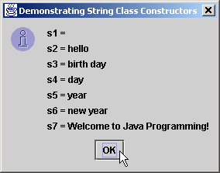
StringConstructors.java
33 // append Strings to output
34 output = "s1 = " + s1 + "\ns2 = " + s2 + "\ns3 = " + s3 +
35 "\ns4 = " + s4 + "\ns5 = " + s5 + "\ns6 = " + s6 +
36 "\ns7 = " + s7;
37
38 JOptionPane.showMessageDialog( null, output,
39 "Demonstrating String Class Constructors",
40 JOptionPane.INFORMATION_MESSAGE );
41
42 System.exit( 0 );
43 }
44
45 } // end class StringConstructors

Slide 10
10.4 String Methods length, charAt and getChars
Method length
  Determine String length
    Like arrays, Strings always “know” their size
    Unlike array, Strings do not have length instance variable
Method charAt
  Get character at specific location in String
Method getChars
  Get entire set of characters in String

Slide 11
StringMiscellaneous.java
Line 28
Line 33
1 // Fig. 10.2: StringMiscellaneous.java
2 // This program demonstrates the length, charAt and getChars
3 // methods of the String class.
4 //
5 // Note: Method getChars requires a starting point
6 // and ending point in the String. The starting point is the
7 // actual subscript from which copying starts. The ending point
8 // is one past the subscript at which the copying ends.
9
10 // Java extension packages
11 import javax.swing.*;
12
13 public class StringMiscellaneous {
14
15 // test miscellaneous String methods
16 public static void main( String args[] )
17 {
18 String s1, output;
19 char charArray[];
20
21 s1 = new String( "hello there" );
22 charArray = new char[ 5 ];
23
24 // output the string
25 output = "s1: " + s1;
26
27 // test length method
28 output += "\nLength of s1: " + s1.length();
29
30 // loop through characters in s1 and display reversed
31 output += "\nThe string reversed is: ";
32
33 for ( int count = s1.length() - 1; count >= 0; count-- )
34 output += s1.charAt( count ) + " ";
35
Determine number of characters in String s1
Append s1’s characters in reverse order to String output

Slide 12
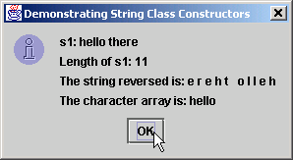
StringMiscellaneous.java
Line 37
36 // copy characters from string into char array
37 s1.getChars( 0, 5, charArray, 0 );
38 output += "\nThe character array is: ";
39
40 for ( int count = 0; count < charArray.length; count++ )
41 output += charArray[ count ];
42
43 JOptionPane.showMessageDialog( null, output,
44 "Demonstrating String Class Constructors",
45 JOptionPane.INFORMATION_MESSAGE );
46
47 System.exit( 0 );
48 }
49
50 } // end class StringMiscellaneous
Copy (some of) s1’s characters to charArray

Slide 13
10.5 Comparing Strings
Comparing String objects
  Method equals
  Method equalsIgnoreCase
  Method compareTo
  Method regionMatches

Slide 14
StringCompare.java
Line 25
Line 31
1 // Fig. 10.3: StringCompare.java
2 // This program demonstrates the methods equals,
3 // equalsIgnoreCase, compareTo, and regionMatches
4 // of the String class.
5
6 // Java extension packages
7 import javax.swing.JOptionPane;
8
9 public class StringCompare {
10
11 // test String class comparison methods
12 public static void main( String args[] )
13 {
14 String s1, s2, s3, s4, output;
15
16 s1 = new String( "hello" );
17 s2 = new String( "good bye" );
18 s3 = new String( "Happy Birthday" );
19 s4 = new String( "happy birthday" );
20
21 output = "s1 = " + s1 + "\ns2 = " + s2 +
22 "\ns3 = " + s3 + "\ns4 = " + s4 + "\n\n";
23
24 // test for equality
25 if ( s1.equals( "hello" ) )
26 output += "s1 equals \"hello\"\n";
27 else
28 output += "s1 does not equal \"hello\"\n";
29
30 // test for equality with ==
31 if ( s1 == "hello" )
32 output += "s1 equals \"hello\"\n";
33 else
34 output += "s1 does not equal \"hello\"\n";
35
Method equals tests two objects for equality using lexicographical comparison
Equality operator (==) tests if both references refer to same object in memory

Slide 15
StringCompare.java
Line 37
Lines 44-48
Line 52 and 59
Test two objects for equality, but ignore case of letters in String
36 // test for equality (ignore case)
37 if ( s3.equalsIgnoreCase( s4 ) )
38 output += "s3 equals s4\n";
39 else
40 output += "s3 does not equal s4\n";
41
42 // test compareTo
43 output +=
44 "\ns1.compareTo( s2 ) is " + s1.compareTo( s2 ) +
45 "\ns2.compareTo( s1 ) is " + s2.compareTo( s1 ) +
46 "\ns1.compareTo( s1 ) is " + s1.compareTo( s1 ) +
47 "\ns3.compareTo( s4 ) is " + s3.compareTo( s4 ) +
48 "\ns4.compareTo( s3 ) is " + s4.compareTo( s3 ) +
49 "\n\n";
50
51 // test regionMatches (case sensitive)
52 if ( s3.regionMatches( 0, s4, 0, 5 ) )
53 output += "First 5 characters of s3 and s4 match\n";
54 else
55 output +=
56 "First 5 characters of s3 and s4 do not match\n";
57
58 // test regionMatches (ignore case)
59 if ( s3.regionMatches( true, 0, s4, 0, 5 ) )
60 output += "First 5 characters of s3 and s4 match";
61 else
62 output +=
63 "First 5 characters of s3 and s4 do not match";
64
Method compareTo compares String objects
Method regionMatches compares portions of two String objects for equality

Slide 16
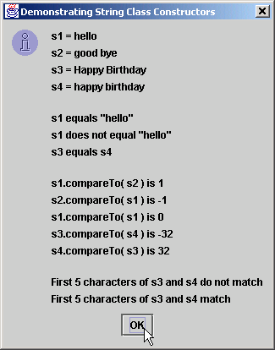
StringCompare.java
65 JOptionPane.showMessageDialog( null, output,
66 "Demonstrating String Class Constructors",
67 JOptionPane.INFORMATION_MESSAGE );
68
69 System.exit( 0 );
70 }
71
72 } // end class StringCompare

Slide 17
StringStartEnd.java
Line 21
Line 31
1 // Fig. 10.4: StringStartEnd.java
2 // This program demonstrates the methods startsWith and
3 // endsWith of the String class.
4
5 // Java extension packages
6 import javax.swing.*;
7
8 public class StringStartEnd {
9
10 // test String comparison methods for beginning and end
11 // of a String
12 public static void main( String args[] )
13 {
14 String strings[] =
15 { "started", "starting", "ended", "ending" };
16 String output = "";
17
18 // test method startsWith
19 for ( int count = 0; count < strings.length; count++ )
20
21 if ( strings[ count ].startsWith( "st" ) )
22 output += "\"" + strings[ count ] +
23 "\" starts with \"st\"\n";
24
25 output += "\n";
26
27 // test method startsWith starting from position
28 // 2 of the string
29 for ( int count = 0; count < strings.length; count++ )
30
31 if ( strings[ count ].startsWith( "art", 2 ) )
32 output += "\"" + strings[ count ] +
33 "\" starts with \"art\" at position 2\n";
34
35 output += "\n";
Method startsWith determines if String starts with specified characters

Slide 18
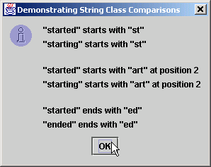
StringStartEnd.java
Line 40
36
37 // test method endsWith
38 for ( int count = 0; count < strings.length; count++ )
39
40 if ( strings[ count ].endsWith( "ed" ) )
41 output += "\"" + strings[ count ] +
42 "\" ends with \"ed\"\n";
43
44 JOptionPane.showMessageDialog( null, output,
45 "Demonstrating String Class Comparisons",
46 JOptionPane.INFORMATION_MESSAGE );
47
48 System.exit( 0 );
49 }
50
51 } // end class StringStartEnd
Method endsWith determines if String ends with specified characters

Slide 19
10.6 String Method hashCode
Hash table
  Stores information using calculation on storable object
    Produces hash code
      Used to choose location in table at which to store object
  Fast lookup

Slide 20
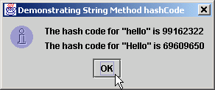
StringHashCode.java
Line 17 and 19
1 // Fig. 10.5: StringHashCode.java
2 // This program demonstrates the method
3 // hashCode of the String class.
4
5 // Java extension packages
6 import javax.swing.*;
7
8 public class StringHashCode {
9
10 // test String hashCode method
11 public static void main( String args[] )
12 {
13 String s1 = "hello", s2 = "Hello";
14
15 String output =
16 "The hash code for \"" + s1 + "\" is " +
17 s1.hashCode() +
18 "\nThe hash code for \"" + s2 + "\" is " +
19 s2.hashCode();
20
21 JOptionPane.showMessageDialog( null, output,
22 "Demonstrating String Method hashCode",
23 JOptionPane.INFORMATION_MESSAGE );
24
25 System.exit( 0 );
26 }
27
28 } // end class StringHashCode
Method hashCode performs hash-code calculation

Slide 21
10.7 Locating Characters and Substrings in Strings
Search for characters in String
  Method indexOf
  Method lastIndexOf

Slide 22
StringIndexMethods.java
Lines 16-23
Lines 26-33
1 // Fig. 10.6: StringIndexMethods.java
2 // This program demonstrates the String
3 // class index methods.
4
5 // Java extension packages
6 import javax.swing.*;
7
8 public class StringIndexMethods {
9
10 // String searching methods
11 public static void main( String args[] )
12 {
13 String letters = "abcdefghijklmabcdefghijklm";
14
15 // test indexOf to locate a character in a string
16 String output = "'c' is located at index " +
17 letters.indexOf( 'c' );
18
19 output += "\n'a' is located at index " +
20 letters.indexOf( 'a', 1 );
21
22 output += "\n'$' is located at index " +
23 letters.indexOf( '$' );
24
25 // test lastIndexOf to find a character in a string
26 output += "\n\nLast 'c' is located at index " +
27 letters.lastIndexOf( 'c' );
28
29 output += "\nLast 'a' is located at index " +
30 letters.lastIndexOf( 'a', 25 );
31
32 output += "\nLast '$' is located at index " +
33 letters.lastIndexOf( '$' );
34
Method indexOf finds first occurrence of character in String
Method lastIndexOf finds last occurrence of character in String

Slide 23
StringIndexMethods.java
35 // test indexOf to locate a substring in a string
36 output += "\n\n\"def\" is located at index " +
37 letters.indexOf( "def" );
38
39 output += "\n\"def\" is located at index " +
40 letters.indexOf( "def", 7 );
41
42 output += "\n\"hello\" is located at index " +
43 letters.indexOf( "hello" );
44
45 // test lastIndexOf to find a substring in a string
46 output += "\n\nLast \"def\" is located at index " +
47 letters.lastIndexOf( "def" );
48
49 output += "\nLast \"def\" is located at index " +
50 letters.lastIndexOf( "def", 25 );
51
52 output += "\nLast \"hello\" is located at index " +
53 letters.lastIndexOf( "hello" );
54
55 JOptionPane.showMessageDialog( null, output,
56 "Demonstrating String Class \"index\" Methods",
57 JOptionPane.INFORMATION_MESSAGE );
58
59 System.exit( 0 );
60 }
61
62 } // end class StringIndexMethods
Methods indexOf and lastIndexOf can also find occurrences of substrings

Slide 24
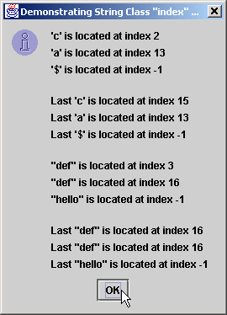
StringIndexMethods.java

Slide 25
10.8 Extracting Substrings from Strings
Create Strings from other Strings
  Extract substrings

Slide 26
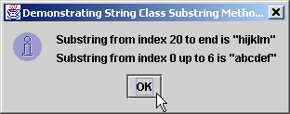
SubString.java
Line 17
Line 20
1 // Fig. 10.7: SubString.java
2 // This program demonstrates the
3 // String class substring methods.
4
5 // Java extension packages
6 import javax.swing.*;
7
8 public class SubString {
9
10 // test String substring methods
11 public static void main( String args[] )
12 {
13 String letters = "abcdefghijklmabcdefghijklm";
14
15 // test substring methods
16 String output = "Substring from index 20 to end is " +
17 "\"" + letters.substring( 20 ) + "\"\n";
18
19 output += "Substring from index 0 up to 6 is " +
20 "\"" + letters.substring( 0, 6 ) + "\"";
21
22 JOptionPane.showMessageDialog( null, output,
23 "Demonstrating String Class Substring Methods",
24 JOptionPane.INFORMATION_MESSAGE );
25
26 System.exit( 0 );
27 }
28
29 } // end class SubString
Beginning at index 20, extract characters from String letters
Extract characters from index 0 to 6 from String letters

Slide 27
10.9 Concatenating Strings
Method concat
  Concatenate two String objects

Slide 28
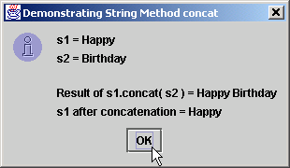
StringConcatenation.java
Line 20
Line 22
1 // Fig. 10.8: StringConcatenation.java
2 // This program demonstrates the String class concat method.
3 // Note that the concat method returns a new String object. It
4 // does not modify the object that invoked the concat method.
5
6 // Java extension packages
7 import javax.swing.*;
8
9 public class StringConcatenation {
10
11 // test String method concat
12 public static void main( String args[] )
13 {
14 String s1 = new String( "Happy " ),
15 s2 = new String( "Birthday" );
16
17 String output = "s1 = " + s1 + "\ns2 = " + s2;
18
19 output += "\n\nResult of s1.concat( s2 ) = " +
20 s1.concat( s2 );
21
22 output += "\ns1 after concatenation = " + s1;
23
24 JOptionPane.showMessageDialog( null, output,
25 "Demonstrating String Method concat",
26 JOptionPane.INFORMATION_MESSAGE );
27
28 System.exit( 0 );
29 }
30
31 } // end class StringConcatenation
Concatenate String s2 to String s1
However, String s1 is not modified by method concat

Slide 29
10.10 Miscellaneous String Methods
Miscellaneous String methods
  Return modified copies of String
  Return character array

Slide 30
StringMiscellaneous2.java
Line 22
Line 26
Line 27
Line 30
Line 33
1 // Fig. 10.9: StringMiscellaneous2.java
2 // This program demonstrates the String methods replace,
3 // toLowerCase, toUpperCase, trim, toString and toCharArray
4
5 // Java extension packages
6 import javax.swing.*;
7
8 public class StringMiscellaneous2 {
9
10 // test miscellaneous String methods
11 public static void main( String args[] )
12 {
13 String s1 = new String( "hello" ),
14 s2 = new String( "GOOD BYE" ),
15 s3 = new String( " spaces " );
16
17 String output = "s1 = " + s1 + "\ns2 = " + s2 +
18 "\ns3 = " + s3;
19
20 // test method replace
21 output += "\n\nReplace 'l' with 'L' in s1: " +
22 s1.replace( 'l', 'L' );
23
24 // test toLowerCase and toUpperCase
25 output +=
26 "\n\ns1.toUpperCase() = " + s1.toUpperCase() +
27 "\ns2.toLowerCase() = " + s2.toLowerCase();
28
29 // test trim method
30 output += "\n\ns3 after trim = \"" + s3.trim() + "\"";
31
32 // test toString method
33 output += "\n\ns1 = " + s1.toString();
34
Use method replace to return s1 copy in which every occurrence of ‘l’ is replaced with ‘L’
Use method toUpperCase to return s1 copy in which every character is uppercase
Use method toLowerCase to return s2 copy in which every character is uppercase
Use method trim to return s3 copy in which whitespace is eliminated
Use method toString to return s1

Slide 31
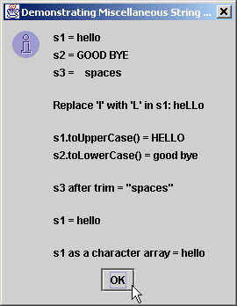
StringMiscellaneous2.java
Line 36
35 // test toCharArray method
36 char charArray[] = s1.toCharArray();
37
38 output += "\n\ns1 as a character array = ";
39
40 for ( int count = 0; count < charArray.length; ++count )
41 output += charArray[ count ];
42
43 JOptionPane.showMessageDialog( null, output,
44 "Demonstrating Miscellaneous String Methods",
45 JOptionPane.INFORMATION_MESSAGE );
46
47 System.exit( 0 );
48 }
49
50 } // end class StringMiscellaneous2
Use method toCharArray to return character array of s1

Slide 32
10.11 Using String Method valueOf
String provides static class methods
  Method valueOf
    Returns String representation of object, data type, etc.

Slide 33
StringValueOf.java
Lines 26-32
1 // Fig. 10.10: StringValueOf.java
2 // This program demonstrates the String class valueOf methods.
3
4 // Java extension packages
5 import javax.swing.*;
6
7 public class StringValueOf {
8
9 // test String valueOf methods
10 public static void main( String args[] )
11 {
12 char charArray[] = { 'a', 'b', 'c', 'd', 'e', 'f' };
13 boolean b = true;
14 char c = 'Z';
15 int i = 7;
16 long l = 10000000;
17 float f = 2.5f;
18 double d = 33.333;
19
20 Object o = "hello"; // assign to an Object reference
21 String output;
22
23 output = "char array = " + String.valueOf( charArray ) +
24 "\npart of char array = " +
25 String.valueOf( charArray, 3, 3 ) +
26 "\nboolean = " + String.valueOf( b ) +
27 "\nchar = " + String.valueOf( c ) +
28 "\nint = " + String.valueOf( i ) +
29 "\nlong = " + String.valueOf( l ) +
30 "\nfloat = " + String.valueOf( f ) +
31 "\ndouble = " + String.valueOf( d ) +
32 "\nObject = " + String.valueOf( o );
33
static method valueOf of class String returns String representation of various types

Slide 34
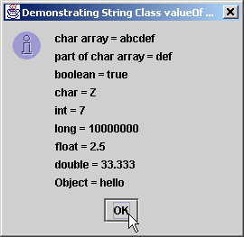
StringValueOf.java
34 JOptionPane.showMessageDialog( null, output,
35 "Demonstrating String Class valueOf Methods",
36 JOptionPane.INFORMATION_MESSAGE );
37
38 System.exit( 0 );
39 }
40
41 } // end class StringValueOf

Slide 35
10.12 String Method intern
String comparisons
  Slow operation
  Method intern improves this performance
    Returns reference to String
    Guarantees reference has same contents as original String

Slide 36
StringIntern.java
Lines 15-20
Line 26
Lines 33-34
1 // Fig. 10.11: StringIntern.java
2 // This program demonstrates the intern method
3 // of the String class.
4
5 // Java extension packages
6 import javax.swing.*;
7
8 public class StringIntern {
9
10 // test String method intern
11 public static void main( String args[] )
12 {
13 String s1, s2, s3, s4, output;
14
15 s1 = new String( "hello" );
16 s2 = new String( "hello" );
17
18 // test strings to determine if they are same
19 // String object in memory
20 if ( s1 == s2 )
21 output = "s1 and s2 are the same object in memory";
22 else
23 output = "s1 and s2 are not the same object in memory";
24
25 // test strings for equality of contents
26 if ( s1.equals( s2 ) )
27 output += "\ns1 and s2 are equal";
28 else
29 output += "\ns1 and s2 are not equal";
30
31 // use String intern method to get a unique copy of
32 // "hello" referred to by both s3 and s4
33 s3 = s1.intern();
34 s4 = s2.intern();
35
String s1 and String s2 occupy different memory locations
String s1 and String s2 have same content
Reference returned by s1.intern() is same as that returned by s2.intern()

Slide 37
StringIntern.java
36 // test strings to determine if they are same
37 // String object in memory
38 if ( s3 == s4 )
39 output += "\ns3 and s4 are the same object in memory";
40 else
41 output +=
42 "\ns3 and s4 are not the same object in memory";
43
44 // determine if s1 and s3 refer to same object
45 if ( s1 == s3 )
46 output +=
47 "\ns1 and s3 are the same object in memory";
48 else
49 output +=
50 "\ns1 and s3 are not the same object in memory";
51
52 // determine if s2 and s4 refer to same object
53 if ( s2 == s4 )
54 output += "\ns2 and s4 are the same object in memory";
55 else
56 output +=
57 "\ns2 and s4 are not the same object in memory";
58
59 // determine if s1 and s4 refer to same object
60 if ( s1 == s4 )
61 output += "\ns1 and s4 are the same object in memory";
62 else
63 output +=
64 "\ns1 and s4 are not the same object in memory";
65

Slide 38
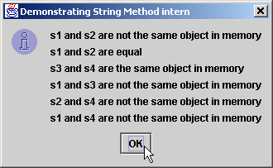
StringIntern.java
66 JOptionPane.showMessageDialog( null, output,
67 "Demonstrating String Method intern",
68 JOptionPane.INFORMATION_MESSAGE );
69
70 System.exit( 0 );
71 }
72
73 } // end class StringIntern

Slide 39
10.13 StringBuffer Class
Class StringBuffer
  When String object is created, its contents cannot change
  Used for creating and manipulating dynamic string data
    i.e., modifiable Strings
  Can store characters based on capacity
    Capacity expands dynamically to handle additional characters
  Uses operators + and += for String concatenation

Slide 40
10.14 StringBuffer Constructors
Three StringBuffer constructors
  Default creates StringBuffer with no characters
    Capacity of 16 characters

Slide 41
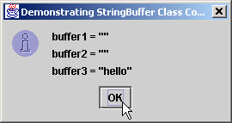
StringBufferConstructors.java
Line 14
Line 15
Line 16
Lines 19-21
1 // Fig. 10.12: StringBufferConstructors.java
2 // This program demonstrates the StringBuffer constructors.
3
4 // Java extension packages
5 import javax.swing.*;
6
7 public class StringBufferConstructors {
8
9 // test StringBuffer constructors
10 public static void main( String args[] )
11 {
12 StringBuffer buffer1, buffer2, buffer3;
13
14 buffer1 = new StringBuffer();
15 buffer2 = new StringBuffer( 10 );
16 buffer3 = new StringBuffer( "hello" );
17
18 String output =
19 "buffer1 = \"" + buffer1.toString() + "\"" +
20 "\nbuffer2 = \"" + buffer2.toString() + "\"" +
21 "\nbuffer3 = \"" + buffer3.toString() + "\"";
22
23 JOptionPane.showMessageDialog( null, output,
24 "Demonstrating StringBuffer Class Constructors",
25 JOptionPane.INFORMATION_MESSAGE );
26
27 System.exit( 0 );
28 }
29
30 } // end class StringBufferConstructors
Default constructor creates empty StringBuffer with capacity of 16 characters
Second constructor creates empty StringBuffer with capacity of specified (10) characters
Third constructor creates StringBuffer with String “hello” and capacity of 16 characters
Method toString returns String representation of StringBuffer

Slide 42
10.15 StringBuffer Methods length, capacity, setLength and ensureCapacity
Method length
  Return StringBuffer length
Method capacity
  Return StringBuffer capacity
Method setLength
  Increase or decrease StringBuffer length
Method ensureCapacity
  Set StringBuffer capacity
  Guarantee that StringBuffer has minimum capacity

Slide 43
StringBufferCapLen.java
Line 17
Line 18
Line 20
Line 23
1 // Fig. 10.13: StringBufferCapLen.java
2 // This program demonstrates the length and
3 // capacity methods of the StringBuffer class.
4
5 // Java extension packages
6 import javax.swing.*;
7
8 public class StringBufferCapLen {
9
10 // test StringBuffer methods for capacity and length
11 public static void main( String args[] )
12 {
13 StringBuffer buffer =
14 new StringBuffer( "Hello, how are you?" );
15
16 String output = "buffer = " + buffer.toString() +
17 "\nlength = " + buffer.length() +
18 "\ncapacity = " + buffer.capacity();
19
20 buffer.ensureCapacity( 75 );
21 output += "\n\nNew capacity = " + buffer.capacity();
22
23 buffer.setLength( 10 );
24 output += "\n\nNew length = " + buffer.length() +
25 "\nbuf = " + buffer.toString();
26
27 JOptionPane.showMessageDialog( null, output,
28 "StringBuffer length and capacity Methods",
29 JOptionPane.INFORMATION_MESSAGE );
30
31 System.exit( 0 );
32 }
33
34 } // end class StringBufferCapLen
Method length returns StringBuffer length
Method capacity returns StringBuffer capacity
Use method ensureCapacity to set capacity to 75
Use method setLength to set length to 10

Slide 44
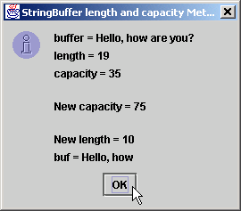
StringBufferCapLen.java
Only 10 characters from StringBuffer are printed
Only 10 characters from StringBuffer are printed

Slide 45
10.16 StringBuffer Methods charAt, setCharAt, getChars and reverse
Manipulating StringBuffer characters
  Method charAt
    Return StringBuffer character at specified index
  Method setCharAt
    Set StringBuffer character at specified index
  Method getChars
    Return character array from StringBuffer
  Method reverse
    Reverse StringBuffer contents

Slide 46
StringBufferChars.java
Lines 16-17
Line 20
Lines 26-27
Line 30
1 // Fig. 10.14: StringBufferChars.java
2 // The charAt, setCharAt, getChars, and reverse methods
3 // of class StringBuffer.
4
5 // Java extension packages
6 import javax.swing.*;
7
8 public class StringBufferChars {
9
10 // test StringBuffer character methods
11 public static void main( String args[] )
12 {
13 StringBuffer buffer = new StringBuffer( "hello there" );
14
15 String output = "buffer = " + buffer.toString() +
16 "\nCharacter at 0: " + buffer.charAt( 0 ) +
17 "\nCharacter at 4: " + buffer.charAt( 4 );
18
19 char charArray[] = new char[ buffer.length() ];
20 buffer.getChars( 0, buffer.length(), charArray, 0 );
21 output += "\n\nThe characters are: ";
22
23 for ( int count = 0; count < charArray.length; ++count )
24 output += charArray[ count ];
25
26 buffer.setCharAt( 0, 'H' );
27 buffer.setCharAt( 6, 'T' );
28 output += "\n\nbuf = " + buffer.toString();
29
30 buffer.reverse();
31 output += "\n\nbuf = " + buffer.toString();
32
Return StringBuffer characters at indices 0 and 4, respectively
Return character array from StringBuffer
Replace characters at indices 0 and 6 with ‘H’ and ‘T,’ respectively
Reverse characters in StringBuffer

Slide 47
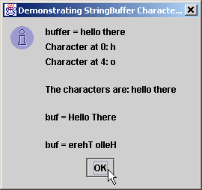
StringBufferChars.java
33 JOptionPane.showMessageDialog( null, output,
34 "Demonstrating StringBuffer Character Methods",
35 JOptionPane.INFORMATION_MESSAGE );
36
37 System.exit( 0 );
38 }
39
40 } // end class StringBufferChars

Slide 48
10.17 StringBuffer append Methods
Method append
  Allow data-type values to be added to StringBuffer

Slide 49
StringBufferAppend.java
Line 24
1 // Fig. 10.15: StringBufferAppend.java
2 // This program demonstrates the append
3 // methods of the StringBuffer class.
4
5 // Java extension packages
6 import javax.swing.*;
7
8 public class StringBufferAppend {
9
10 // test StringBuffer append methods
11 public static void main( String args[] )
12 {
13 Object o = "hello";
14 String s = "good bye";
15 char charArray[] = { 'a', 'b', 'c', 'd', 'e', 'f' };
16 boolean b = true;
17 char c = 'Z';
18 int i = 7;
19 long l = 10000000;
20 float f = 2.5f;
21 double d = 33.333;
22 StringBuffer buffer = new StringBuffer();
23
24 buffer.append( o );
25 buffer.append( " " );
26
Append String “hello” to StringBuffer

Slide 50
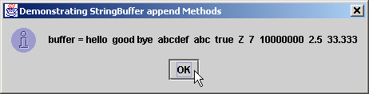
StringBufferAppend.java
Line 27
Line 29
Line 31
Lines 33-43
27 buffer.append( s );
28 buffer.append( " " );
29 buffer.append( charArray );
30 buffer.append( " " );
31 buffer.append( charArray, 0, 3 );
32 buffer.append( " " );
33 buffer.append( b );
34 buffer.append( " " );
35 buffer.append( c );
36 buffer.append( " " );
37 buffer.append( i );
38 buffer.append( " " );
39 buffer.append( l );
40 buffer.append( " " );
41 buffer.append( f );
42 buffer.append( " " );
43 buffer.append( d );
44
45 JOptionPane.showMessageDialog( null,
46 "buffer = " + buffer.toString(),
47 "Demonstrating StringBuffer append Methods",
48 JOptionPane.INFORMATION_MESSAGE );
49
50 System.exit( 0 );
51 }
52
53 } // end StringBufferAppend
Append String “good bye”
Append “a b c d e f”
Append “a b c”
Append boolean, char, int, long, float and double

Slide 51
10.18 StringBuffer Insertion and Deletion Methods
Method insert
  Allow data-type values to be inserted into StringBuffer
Methods delete and deleteCharAt
  Allow characters to be removed from StringBuffer

Slide 52
StringBufferInsert.java
1 // Fig. 10.16: StringBufferInsert.java
2 // This program demonstrates the insert and delete
3 // methods of class StringBuffer.
4
5 // Java extension packages
6 import javax.swing.*;
7
8 public class StringBufferInsert {
9
10 // test StringBuffer insert methods
11 public static void main( String args[] )
12 {
13 Object o = "hello";
14 String s = "good bye";
15 char charArray[] = { 'a', 'b', 'c', 'd', 'e', 'f' };
16 boolean b = true;
17 char c = 'K';
18 int i = 7;
19 long l = 10000000;
20 float f = 2.5f;
21 double d = 33.333;
22 StringBuffer buffer = new StringBuffer();
23

Slide 53
StringBufferInsert.java
Lines 24-40
Line 45
Line 46
24 buffer.insert( 0, o );
25 buffer.insert( 0, " " );
26 buffer.insert( 0, s );
27 buffer.insert( 0, " " );
28 buffer.insert( 0, charArray );
29 buffer.insert( 0, " " );
30 buffer.insert( 0, b );
31 buffer.insert( 0, " " );
32 buffer.insert( 0, c );
33 buffer.insert( 0, " " );
34 buffer.insert( 0, i );
35 buffer.insert( 0, " " );
36 buffer.insert( 0, l );
37 buffer.insert( 0, " " );
38 buffer.insert( 0, f );
39 buffer.insert( 0, " " );
40 buffer.insert( 0, d );
41
42 String output =
43 "buffer after inserts:\n" + buffer.toString();
44
45 buffer.deleteCharAt( 10 ); // delete 5 in 2.5
46 buffer.delete( 2, 6 ); // delete .333 in 33.333
47
48 output +=
49 "\n\nbuffer after deletes:\n" + buffer.toString();
50
51 JOptionPane.showMessageDialog( null, output,
52 "Demonstrating StringBufferer Inserts and Deletes",
53 JOptionPane.INFORMATION_MESSAGE );
54
55 System.exit( 0 );
56 }
57
58 } // end class StringBufferInsert
Use method insert to insert data types in beginning of StringBuffer
Use method deleteCharAt to remove character from index 10 in StringBuffer
Remove characters from indices 2 through 5 (inclusive)

Slide 54
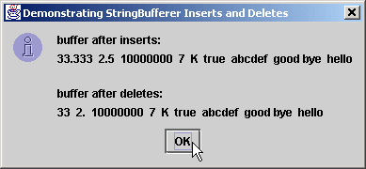
StringBufferInsert.java

Slide 55
10.19 Class StringTokenizer
Tokenizer
  Partition String into individual substrings
  Use delimiter
  Java offers java.util.StringTokenizer

Slide 56
TokenTest.java
Line 29
1 // Fig. 10.20: TokenTest.java
2 // Testing the StringTokenizer class of the java.util package
3
4 // Java core packages
5 import java.util.*;
6 import java.awt.*;
7 import java.awt.event.*;
8
9 // Java extension packages
10 import javax.swing.*;
11
12 public class TokenTest extends JFrame {
13 private JLabel promptLabel;
14 private JTextField inputField;
15 private JTextArea outputArea;
16
17 // set up GUI and event handling
18 public TokenTest()
19 {
20 super( "Testing Class StringTokenizer" );
21
22 Container container = getContentPane();
23 container.setLayout( new FlowLayout() );
24
25 promptLabel =
26 new JLabel( "Enter a sentence and press Enter" );
27 container.add( promptLabel );
28
29 inputField = new JTextField( 20 );
30
31 inputField.addActionListener(
32
33 // anonymous inner class
34 new ActionListener() {
35
inputField contains String to be parsed by StringTokenizer

Slide 57
TokenTest.java
Lines 41-42
Line 45
Lines 47-48
36 // handle text field event
37 public void actionPerformed( ActionEvent event )
38 {
39 String stringToTokenize =
40 event.getActionCommand();
41 StringTokenizer tokens =
42 new StringTokenizer( stringToTokenize );
43
44 outputArea.setText( "Number of elements: " +
45 tokens.countTokens() + "\nThe tokens are:\n" );
46
47 while ( tokens.hasMoreTokens() )
48 outputArea.append( tokens.nextToken() + "\n" );
49 }
50
51 } // end anonymous inner class
52
53 ); // end call to addActionListener
54
55 container.add( inputField );
56
57 outputArea = new JTextArea( 10, 20 );
58 outputArea.setEditable( false );
59 container.add( new JScrollPane( outputArea ) );
60
61 setSize( 275, 260 ); // set the window size
62 show(); // show the window
63 }
64
65 // execute application
66 public static void main( String args[] )
67 {
68 TokenTest application = new TokenTest();
69
Use StringTokenizer to parse String stringToTokenize with default delimiter “ \n\t\r”
Count number of tokens
Append next token to outputArea, as long as tokens exist

Slide 58
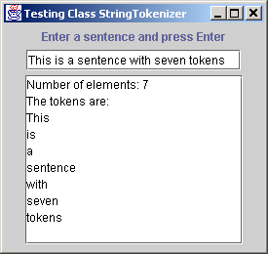
TokenTest.java
70 application.addWindowListener(
71
72 // anonymous inner class
73 new WindowAdapter() {
74
75 // handle event when user closes window
76 public void windowClosing( WindowEvent windowEvent )
77 {
78 System.exit( 0 );
79 }
80
81 } // end anonymous inner class
82
83 ); // end call to addWindowListener
84
85 } // end method main
86
87 } // end class TokenTest

